Slide 1
Product Sales Analysis
SAKSHI KAMBLE

Slide 2
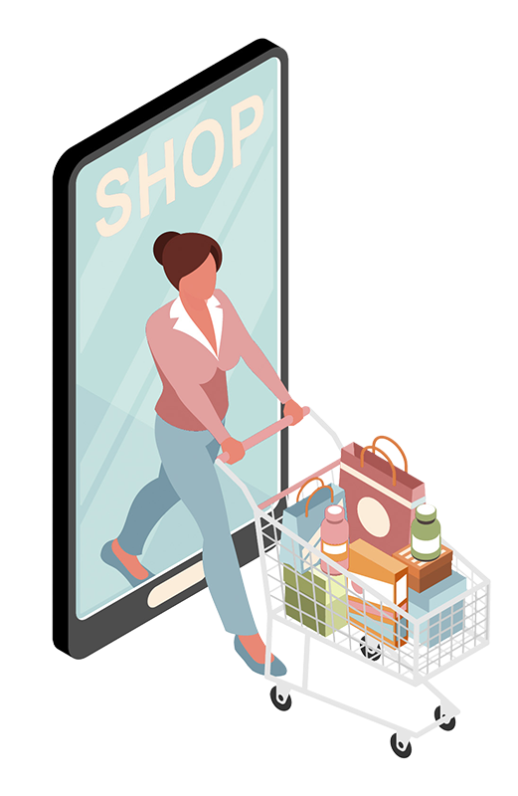
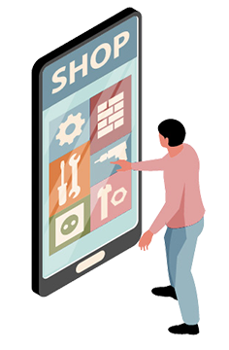
ABOUT PROJECT
This dataset provides a comprehensive view of sales transactions, covering details about the product, financials, and customer demographics.
sales performance across various product categories.
the distribution of quantity sold and the tax generated (5% of sales) across different product categories
the payment preferences of customers across cities.

Slide 3
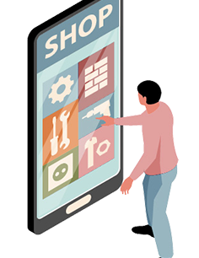
ABOUT PROJECT
This dataset provides a comprehensive view of sales transactions, covering details about the product, financials, and customer demographics.
sales performance across various product categories.
the distribution of quantity sold and the tax generated (5% of sales) across different product categories
the payment preferences of customers across cities.

Slide 4
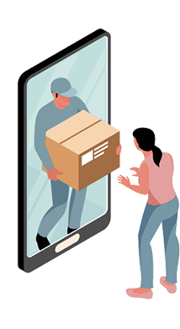
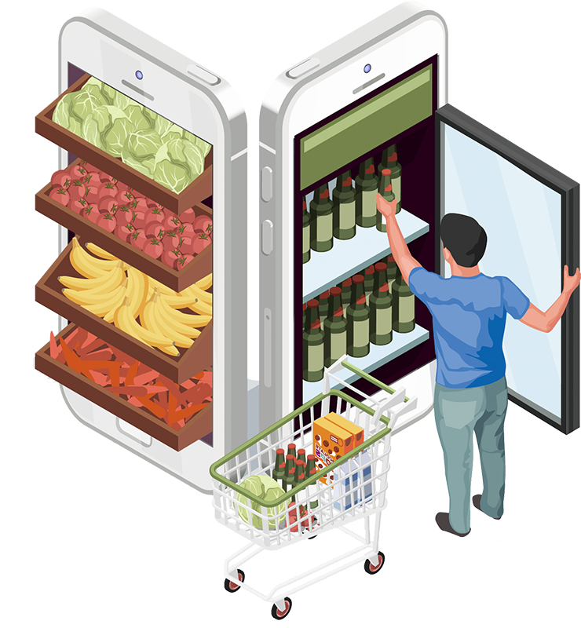
PROBLEM STATEMENTS
1) A retail store wants to analyse the sales performance across various product categories.
2) Analyse sales data to understand the distribution of quantity sold and the tax generated (5% of sales) across different product categories in these cities.
3) A retail company aims to analyse the purchasing behaviour of male and female customers across different product categories.
4) A retail chain is analysing the payment preferences of customers across three cities
5) A retail company is analysing customer satisfaction ratings across different product categories. The data is segmented by gender (Male and Female)
and membership status (Member and Normal) to understand the overall satisfaction levels and identify areas for improvement.
6) A retail business is analysing its financial performance across six product categories:

Slide 5
PRODUCTS Vs UNIT PRICE 1
analyse the sales performance across various product categories.
Top Performing Category: Fashion Accessories has the highest total unit price of $10,173.35, indicating it may be the most profitable category.
Most Popular Category: Electronic Accessories has the highest quantity sold at 971 units, suggesting strong consumer demand.
Least Popular Category: Health and Beauty has the lowest quantity sold at 854 units, which might indicate a need for promotional efforts.

Slide 6
PRODUCTS USED BY MALE AND FEMALE 2
analyse the purchasing behaviour of male and female customers
Top-Selling Category:
Food and Beverages is the top-selling category with a total sales of ₹56,144.84, driven primarily by female customers, who contributed ₹33,170.92.
Gender-Based Preferences:
Female Customers: Prefer Food and Beverages and Fashion Accessories, contributing more significantly to these categories.

Slide 7
CITY Vs QUANTITY 3
the distribution of quantity sold and the tax generated (5% of sales) across different product
INSIGHTS:
Mumbai leads in total quantity sold (1,859 units) and generates a tax of ₹5,057.16, primarily driven by the Home and Lifestyle category.

Slide 8
CITY Vs PRODUCTS 4
analysing the payment preferences of customers
Ewallet is the most popular payment method in Mumbai (126 transactions) and Satara (113 transactions), suggesting a growing trend towards digital payments in these cities.
Cash is the most used payment method in Pune (124 transactions), showing that cash remains a significant mode of payment.

Slide 9
CUSTOMER TYPE Vs RATINGS 5
analysing customer satisfaction ratings across different product categories
Female Customers have a slightly higher overall satisfaction rating (3,489.2) compared to Male Customers (3,483.5).

Slide 10
PRODUCTS Vs GROSS INCOME 6
analysing its financial performance
Food and Beverages leads in both total sales (₹56,144.84) and gross income (₹2,673.56), indicating it is the most profitable category.
Health and Beauty has the lowest total sales (₹49,193.74) and gross income (₹2,342.56), suggesting this category may need strategic improvements to boost profitability

Slide 11
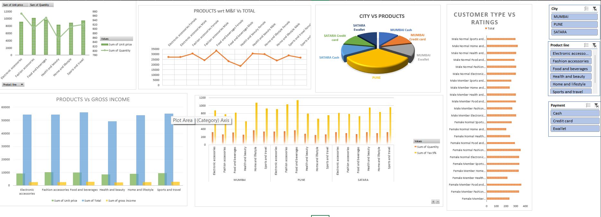

Slide 12
CONCLUSION
Product Lines:
Popular Product Lines: "Electronic accessories" and "Health and beauty" seem to be the most frequently purchased products.
2. Payment Methods:
E-wallet Usage: The E-wallet payment method seems to be the most popular across multiple transactions, especially in Mumbai.
3. Customer Satisfaction (Rating):
Ratings: Ratings range from 4.1 to 9.6. Customers purchasing "Health and beauty" and "Food and beverages" products seem to give higher ratings

Slide 13
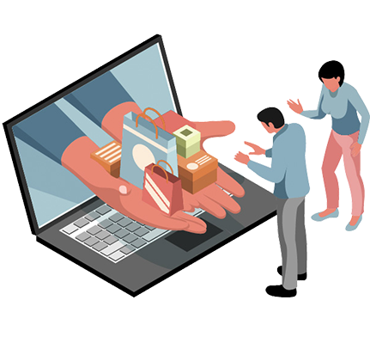
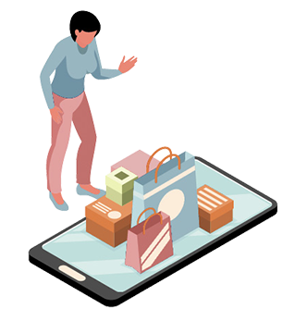
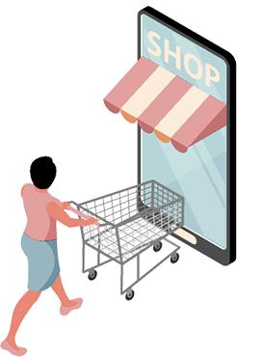

THANK YOU …

